Slide 1
Digital Image Processing
Associate Prof. Zhang Qingfeng(张庆丰) Department of Computer Science, Jinan University
Office Room: 415, Nanhailou Building
Email: zqf135@qq.com
1

Slide 2
Chapter 4
Filtering in the frequency Domain (I)
2

Slide 3
Contents
1. Background
2. Preliminary Concepts
3. The Discrete Fourier Transform
4. Some properties of the 2-D DFT
3

Slide 4
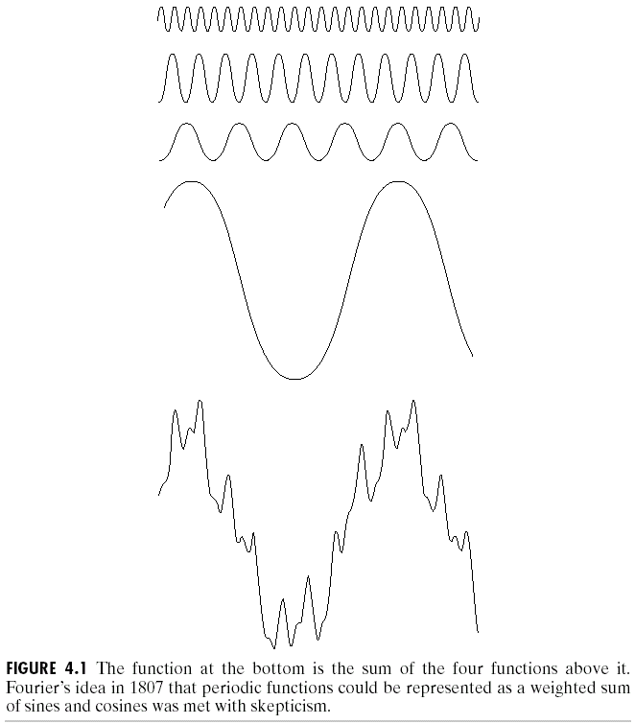
1. Background
Fourier Series and Transform
Jean Baptiste Joseph['dʒəʊzɪf]
Fourier [ˈfuriei] ( born in 1768)
Any periodic function can be expressed as a weighted sum of sines and/or cosines (Fourier series)

Slide 5
Background
Other functions that are not periodic can be expressed as an integral of sines and/or cosines multiplied by a weighing function (the formulation in this case is Fourier Transform)
Functions can be recovered by the inverse operation with no loss of information
Applications to Image Enhancement

Slide 6
2. Preliminary Concepts
Complex Numbers
Complex number is defined as
C=R + jI ; where
R denotes the real part of the complex number and I its imaginary part ;
Conjugate ( 共轭 ) of a complex number C, denoted C* : C * =R – jI
Complex number R+jI is a point in the rectangular coordinate system of the complex plane
Notes:
Abscissa [æbˈsɪsə] 横坐标轴 ordinate ordinate [ˈɔ:dɪneit]

Slide 7
Complex Numbers
can be represented in polar coordinates by
Where is the length of the vector from the origin of the complex plane to point (R,I).
is the angle between the vector and the real axis.
Euler’s formula

Slide 8


Fourier Series （傅里叶级数）
If f(t) is a periodic function of a continuous variable t, with period T
where
Notes:
It is called Fourier series

Slide 9


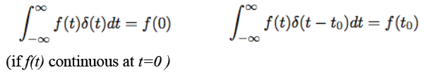
Impulses and their Sifting Property
Unit impulse （单位脉冲）of a continuous variable t located at t=0 :
where
Sifting property (筛选属性)

Slide 10
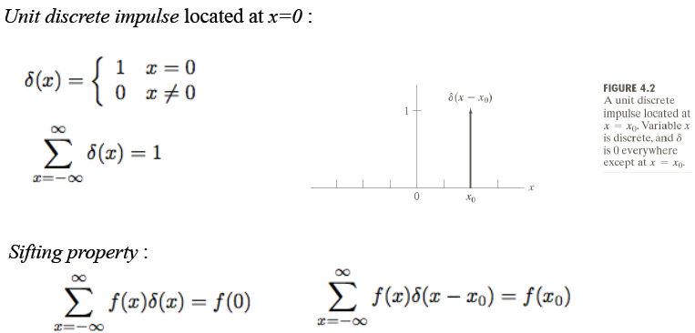
Preliminary Concepts

Slide 11


The Fourier Transform of Functions of One Continuous Variable
Fourier Transform of a continuous function f(t) of a continuous variable t :
Inverse Fourier Transform

Slide 12

Example: Fourier Transform of a unit impulse located at the origin:
Fourier Transform of a unit impulse located at
t = t₀ :

Slide 13
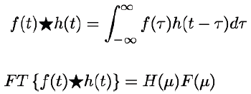
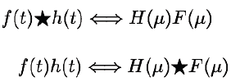
Convolution (卷积)
Convolution of functions f(t) and h(t), of one continuous variable t :
Fourier Transform pairs:

Slide 14
3. The Discrete Fourier Transform (DFT)
The one-dimensional Fourier transform and its inverse
Fourier transform (continuous case)
Inverse Fourier transform:
The two-dimensional Fourier transform and its inverse
Fourier transform (continuous case)
Inverse Fourier transform:
14

Slide 15
The one-dimensional Fourier transform and its inverse
Fourier transform (discrete case) DTC
x is image coordinate variable and integer,
u is the frequency variable and integer,
M is the number of samples of f(x).
15

Slide 16
Each term of the Fourier transform (i.e. the value of F(u) for each value of u) is composed of the sum of all values of the function f(x).
The values of f(x), are multiplied by sines and cosines of various frequencies.
One can compare the Fourier transform to a glass prism.
The prism is a physical device that separates light into various color components, each based on its wavelength (or frequency).
16

Slide 17
The Fourier transform can be considered as a ‘Mathematical prism’ that separates a function into various components, based on frequency content
Given F(u), we can get the original function using the one-dimensional Inverse Fourier transform
17

Slide 18
Since and the fact
then discrete Fourier transform can be redefined
Frequency (time) domain: the domain (values of u) over which the values of F(u) range; because u determines the frequency of the components of the transform.
Frequency (time) component: each of the M terms of F(u).
18

Slide 19
F(u) can be expressed in polar coordinates:
R(u): the real part of F(u)
I(u): the imaginary part of F(u)
Power spectrum (spectral density)功率谱:
19

Slide 20
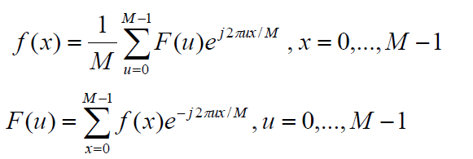
From
We know that the signal f(x) can be reconstructed from F(u) completely
A signal can be represented in time/space domain as well as in frequency domain
We are going to study image enhancement methods in frequency domain
20

Slide 21
The Figure below shows the results for K=16 points. We find
the height of the spectrum doubled as the area under the curve in the x-domain doubled
the number of zeros in the spectrum in the same interval doubled as the length of the function doubled.
Note the reciprocal(互逆的) nature of the Fourier transform pairs.
That means Δx and Δu are inversely related by the equation: Δu = (1/(M. Δx))
21

Slide 22
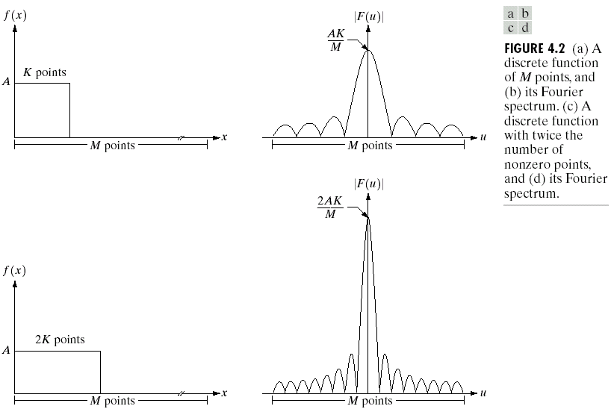

Slide 23
The 2D Fourier transform and its inverse
Fourier transform (discrete case)
Let f(x,y) for x=0,1,2, ..., M-1 and y=1,2, ..., N-1 denote an M×N image. The 2D DFT of f is given by
The frequency domain is simply the coordinate system spanned by F(u,v) with u and v as frequency variables.

Slide 24
Inverse Fourier transform (discrete case)
u, v : the transform or frequency variables
x, y : the spatial or image variables
Thus, given F(u,v), we can obtain f(x,y) back by means of the inverse DFT.

Slide 25
The value of the transform at the origin of the frequency domain that is F(0,0) is called the dc component(直流分量) of the Fourier transform.
Even if f(x,y) is real, its transform is complex.
The principal method of visually analyzing a transform is to compute its spectrum that is the magnitude of F(u,v).

Slide 26
We define the Fourier spectrum, phase angle, and power spectrum as follows:
R(u,v): the real part of F(u,v)
I(u,v): the imaginary part of F(u,v)
26

Slide 27
4. Some properties of 2-D DFT
By direct substitution, we can show that
F(u,v)=F(u+M, v)=F(u, v+N)=F(u+M, v+N)
This implies that DFT is infinitely periodic in both u and v directions, with the periodicity M and N.
The same is true in the inverse DFT also.
27

Slide 28
It is common practice to multiply the input image function by (-1)^{x+y} prior to computing the Fourier transform. Due to the properties of exponentials, it is not difficult to show that :
28

Slide 29
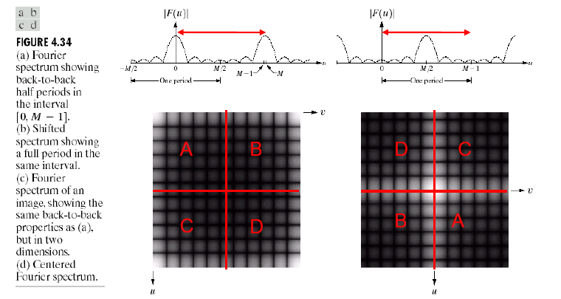
29

Slide 30
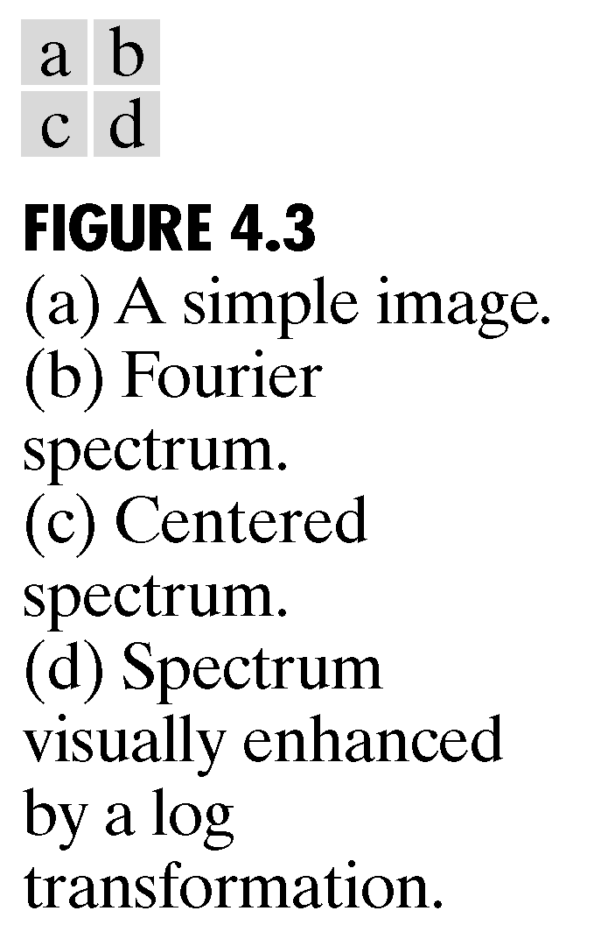
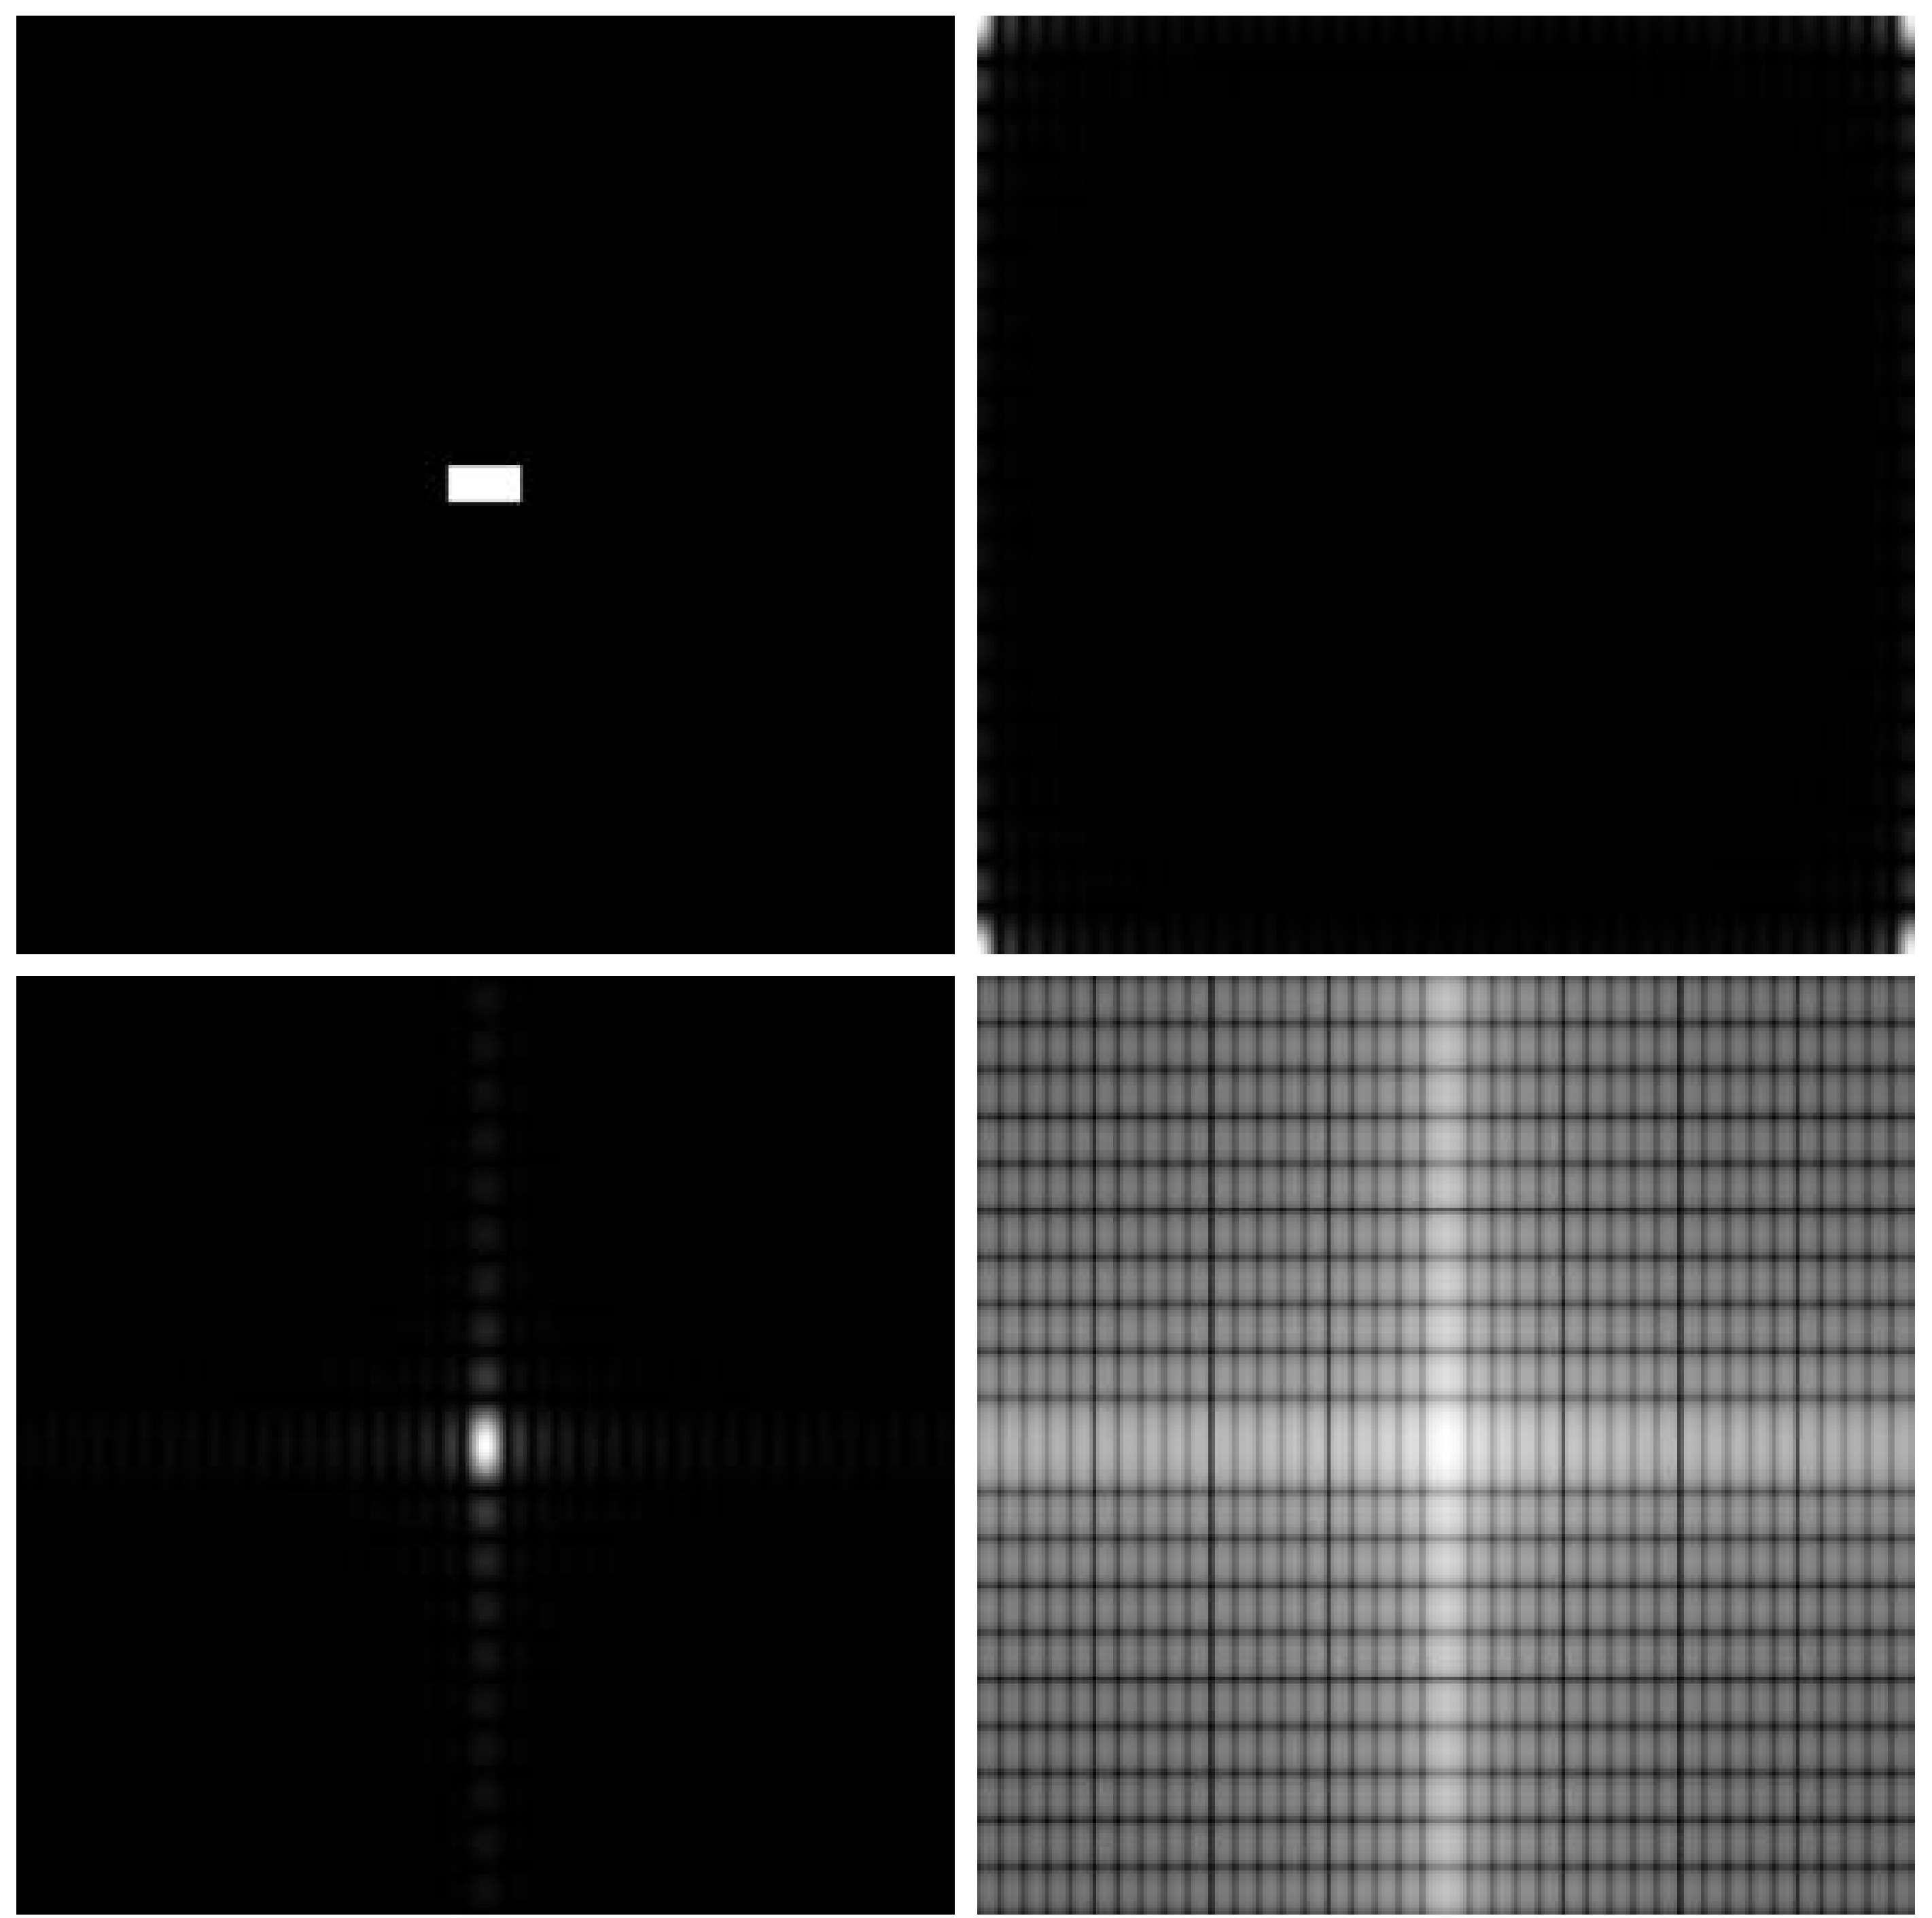
30

Slide 31
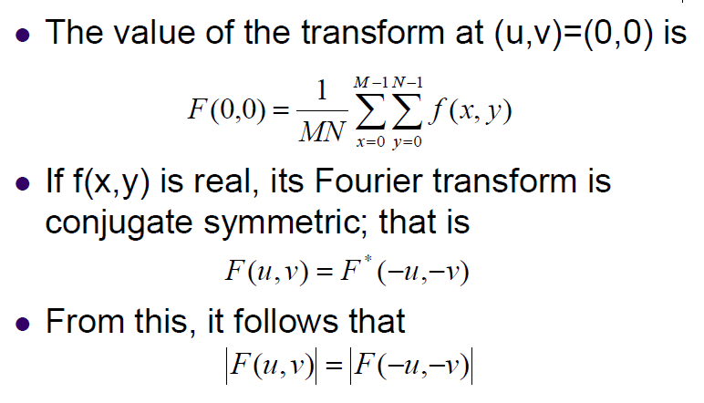
31

Slide 32
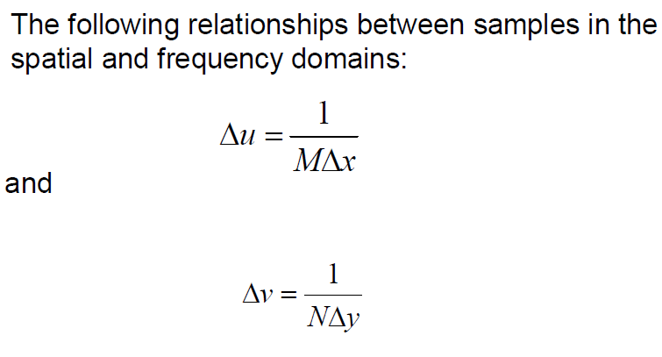
32

Slide 33
Computing and Visualizing the 2D DFT
The FFT of an M × N image array is obtained by the syntax
F=fft2(f)
and with padding by the syntax
F=fft2(f, P,Q)
The Fourier spectrum is obtained as
S=abs(F)
33

Slide 34
Computing and Visualizing the 2D DFT
The funcion F=fft2 (f) moves the origin of transform to the center of the frequency rectangle.
Fc=fftshift (F)
Log transformation:
S2=log(1+abs(Fc))
Function ifftshift reverses the centering:
F=ifftshift(Fc)
34

Slide 35
To compute inverse FFT
f=ifft2 (F)
If the input used to compute F is real then the inverse should also be real. However fft2 often has small imaginary components resulting from round-off errors. It is good practice to extract the real part of the result:
f=real(ifft2(F))
35

Slide 36
36

Slide 37

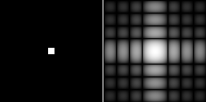
Example: Two-Dimensional DFT with Different Functions
Sine wave
Its DFT
Rectangle
Its DFT

Slide 38

Convolution Theory
Convolution theory is the bridge connecting spatial domain and frequency (Fourier) domain
Convolution of two functions f(x,y) and h(x,y) of size M×N is defined by
If the size of h(x,y) is smaller than M×N, it is first padded by zero to make the size M×N􀂄
f(x,y) and h(x,y) are inherently(固有的) periodic (周期性)􀂄
38

Slide 39


Convolution Theory
Convolution theory says that the Fourier transform of g(x,y) is equal to the product of the Fourier transform f(x,y) and that of h(x,y)􀂄
Similarly the Fourier transform of the product of f(x,y) and h(x,y) is equal to the convolution of the Fourier transform of f(x,y) and that of h(x,y)
39

Slide 40
Summary
In this lecture, we have learned
Preliminary Concepts
The Discrete Fourier Transform of 1D and 2D
Some Properties of the 2-D Discrete Fourier Transform
How to do FFT in Matlab
40

Slide 41
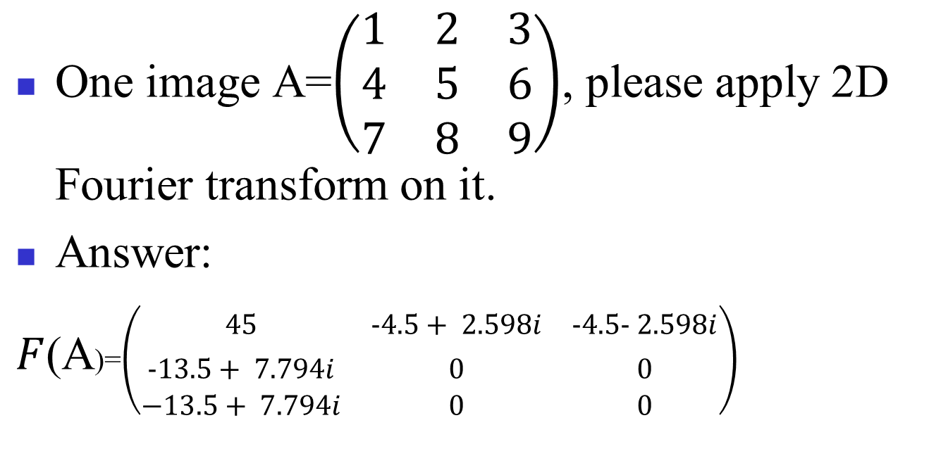
problem
One image A=$\left(\begin{matrix}1 & 2 & 3 \\ 4 & 5 & 6 \\ 7 & 8 & 9\end{matrix}\right)$, please apply 2D Fourier transform on it.
Answer:
$F$(A)=$\left(\begin{matrix}45 & −4.5+ 2.598i & −4.5− 2.598i \\ −13.5+ 7.794i & 0 & 0 \\ −13.5+ 7.794i & 0 & 0\end{matrix}\right)$

